Slide 1
WP4. Implementation of developed master curricula and trainings
Zakhar Maletskyi & Harsha Ratnaweera
progress meeting 23 June 2021
follow up of the meetings: 17 January 2021, 15 September 2020
This project has been funded with support from the European Commission. This publication reflects the views only of the author, and the Commission cannot be held responsible for any use which may be made of the information contained therein

Slide 2
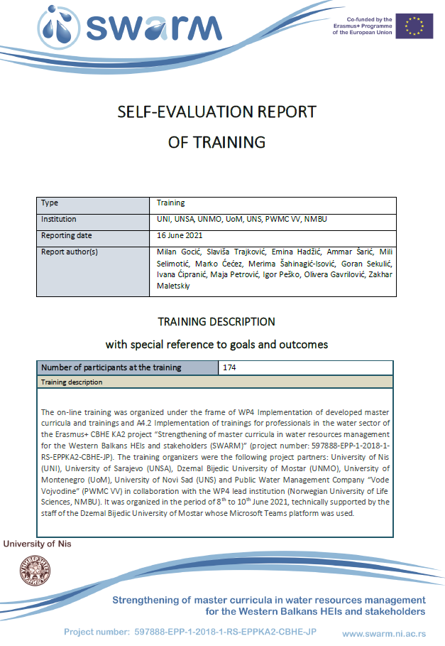
What have we promised in the application?

Slide 3
WP4 Inputs & Outputs
Catalogue of competences
6 trainings
90 WB teaching staff members trained
Oct-Nov 2020
Curricula implementation
Trainings for professionals
7 x 3-days trainings
210 professionals
One self-evaluation report per training
SWARM set of courses
WP 4
Materials for trainings
← Third project year →
10-15 students per WB univ enrolled
One self-evaluation report per term – twice a year
Accreditation of curricula
Students enrolled and interested
Dec-20/Jan-21
Self evaluations
of curricula and trainings
Equipped laboratories
Professionals are interested
15 Oct 2021

Slide 4
Curricula Implementation

Slide 5
Enrolled students
University | Rough estimation / formal proof / status of studies
 | 15 September 2020 | Update 23 June 2021
UoNiš | 15 students at BSc – June 2021 / 5-10 MSc end of 2020 / locked until accreditation / 50:50
UoNoviSad | 4-5 MSc/year – enrolment in process by end of October 2020 / online, not clear how | 4
UoSarajevo | 15 MSc – enrolment by end of 2020 / 50:50 | 7 (I year), 17 (II year)
UoMostar | 10 MSc – enrolment by October 2020 / ???
UoPriština | Follow up email | 10
CollUrosevac | 15 students, awaiting accreditation
UoMontenegro | 5 students

Slide 6
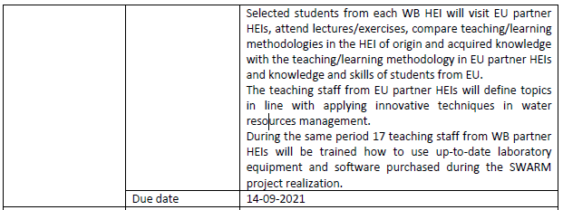
Winter / summer schools
Format of the Summer School 2021
Online lectures + workshops (June 2021)
Participants of the online course: 1 week in November – decision in October (5 days funded from SWARM + co-funding from NMBU)
2 students participate from SWARM project:

Slide 7
Trainings for professionals

Slide 8
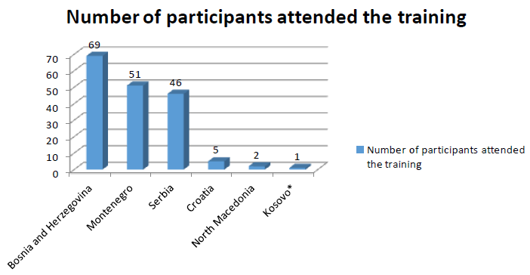
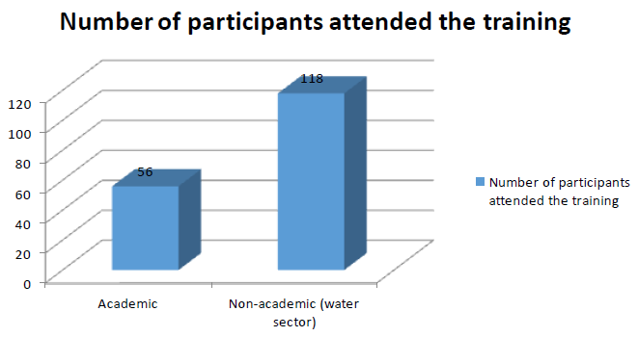

Slide 9
